Slide 1
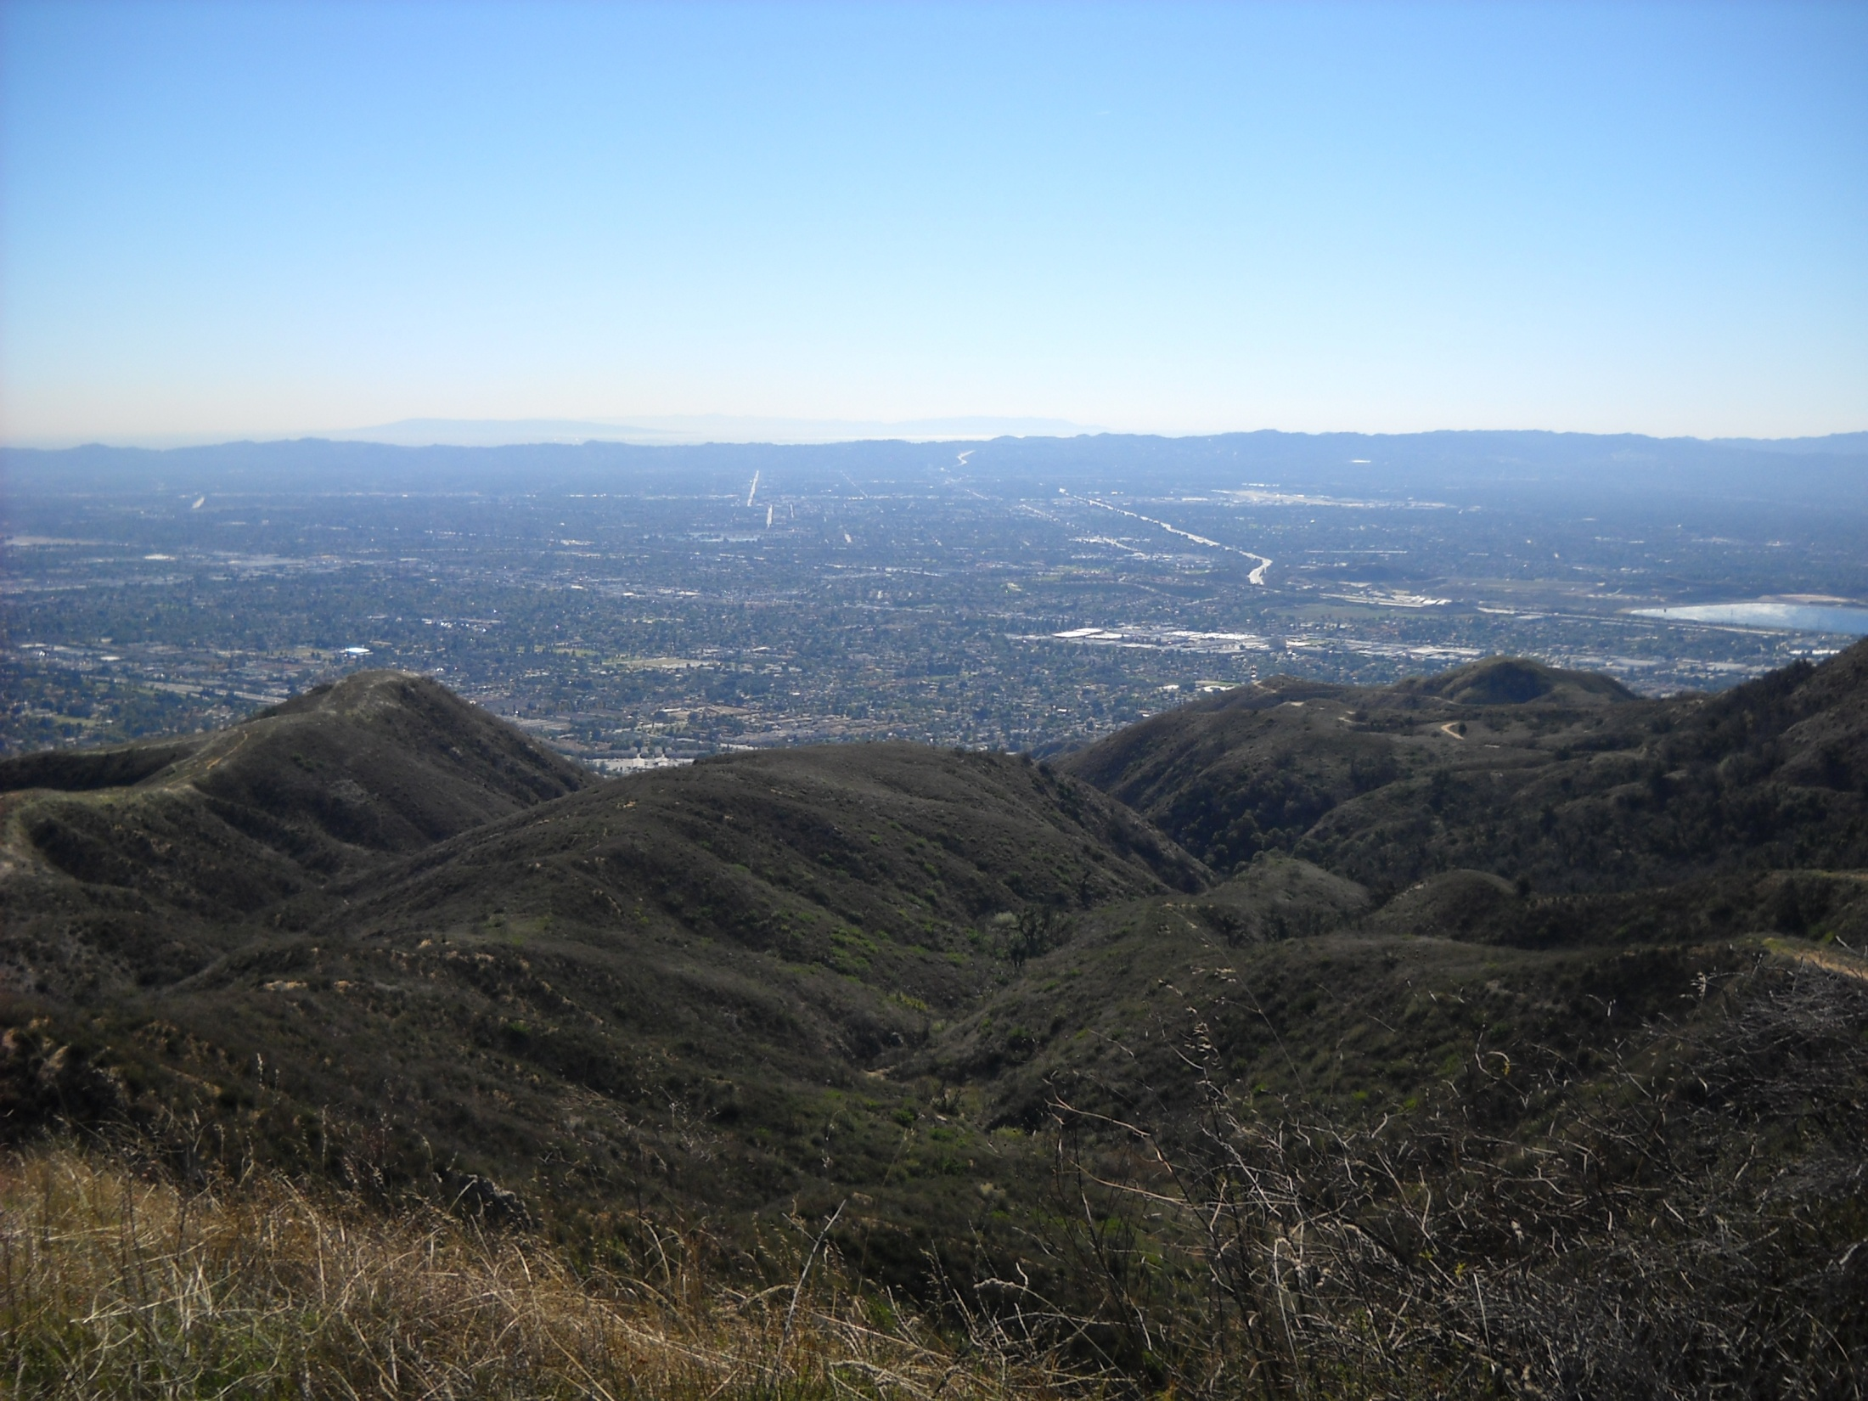
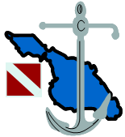
Fish ID
The Catalina Marine Society
Mike Doran, Craig Gelpi
and Gerald Winkel
June 27, 2015
www.catalinamarinesociety.org
© Catalina Marine Society
Notes:
Happy to be here. I’m a scientist and long-time diver. I hold various offices with the Catalina Marine Society, including Chief Scientist.
This is our first presentation since we went public a few months ago and the first describing our work to a dive club.
I’ll be talking about what is the Catalina Marine Society (CMS), how origins and what are we doing now.

Slide 2
Welcome
The Catalina Marine Society and Reef are happy to bring this class to you in this great and most appropriate setting.
Thanks for joining us for our inaugural Fish Identification class.

Slide 3
Catalina Marine Society
We are chartered to advance the scientific understanding of our local ocean, including Santa Catalina island, the northern Channel Islands and the San Diego area, by mustering volunteer resources.

Slide 4
CMS Activities
  We conduct field campaigns;
  Analyze data from our experiments as well as others;
  Make original scientific contributions;
  Publish a magazine;
  And, conduct typical business and club activities.

Slide 5
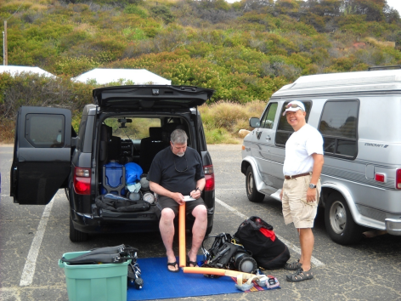
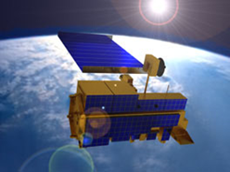
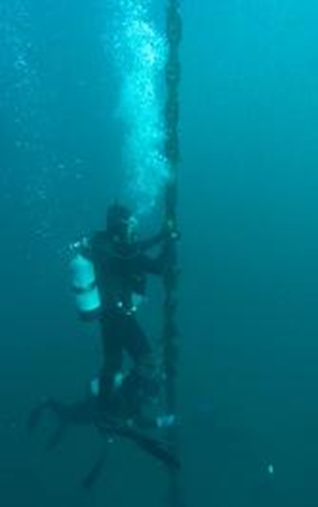
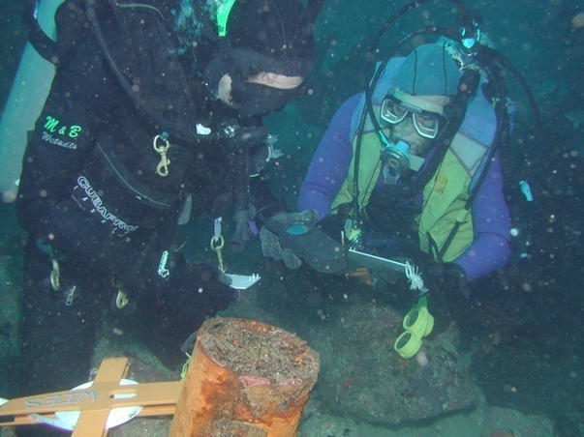
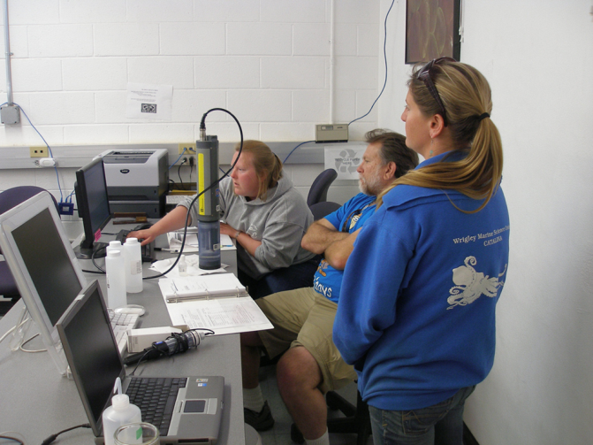
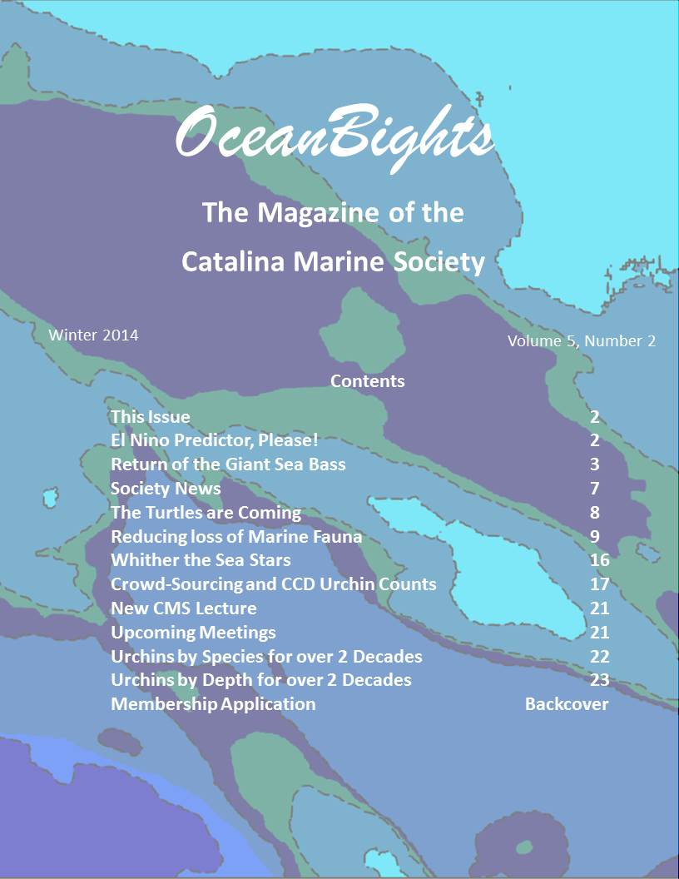
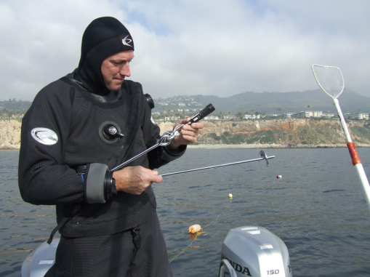
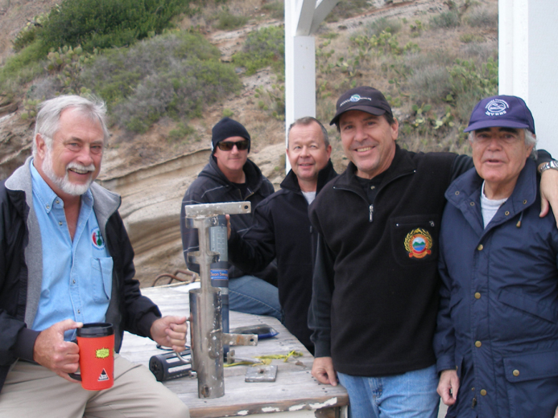
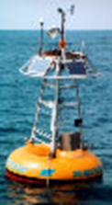
CMS Activities

Slide 6
CMS Accomplishments
Understanding vertical mixing in the Bight
Internal waves driven by wind and tides at Two Harbors
Analysis of Catalina urchins’ relation to El Nino
Construction and Maintenance of the Continental Thermograph Array
Ocean chemistry measurements at Catalina

Slide 7
Volunteer Opportunities
Boaters (no scientific expertise required)
Divers
Writers
Researchers
Number crunchers
Photographers
Social Planners/Organizers
Members/Supporters
If you are interested, we will find productive activities for you.

Slide 8
Lecturers/Hosts
Gerald Winkel
  Member of Reef’s West Coast Assessment team and an active diver who has conducted over 350 dives in California. He also volunteers for Catalina Marine Society, Reef Check, Diveheart and the Laguna Ocean Foundation. He also assists local universities and researchers with data collection.
Mike Doran
  Mike is a board member of CMS and past president of the CCD. He has dived Southern California for 40 years, and has coordinated and participated in census dives for over 15 years, analysis of which was presented recently at the Southern California Academy of Sciences. He has organized our diving activities at Catalina including multiple deployments of electronic instrumentation. He has B.S. in marine biology.

Slide 9

Enjoy the Day
We hope what you learn today will make your experiences in the ocean more enjoyable.
We also hope you think about The Society, what it does and perhaps how you can add value to the Society’s work.
Amazon Smile found at
www.catalinamarinesociety.org

