Slide 1
Two Decades of CMS California Islands Research: Seasonal temperatures, Internal Waves, Productivity and Ocean Acidification Refugia
Craig G. Gelpi
Catalina Marine Society
California Islands Symposium
Ventura, CA
November 6-10, 2023

Slide 2
Outline
The oceanographic and geophysical situation
Temperature
Seasonal modulation
Daily modulation: Internal waves
Episodic wind events
Chlorophyll (remote sensing)
Acidity, pH (Catalina Dynamic Ocean Chemistry (CDOC) program)
Daily modulation
Seasonal modulation
Catalina and Southern California Bight
Conclusions
Acknowledgements and References

Slide 3
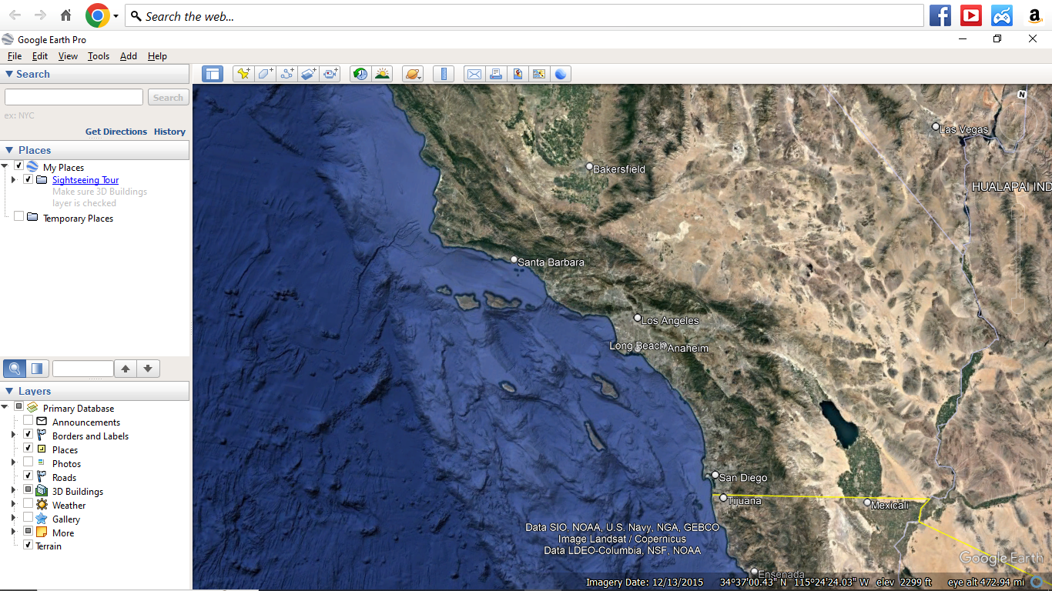
Geographic Scenario

Slide 4
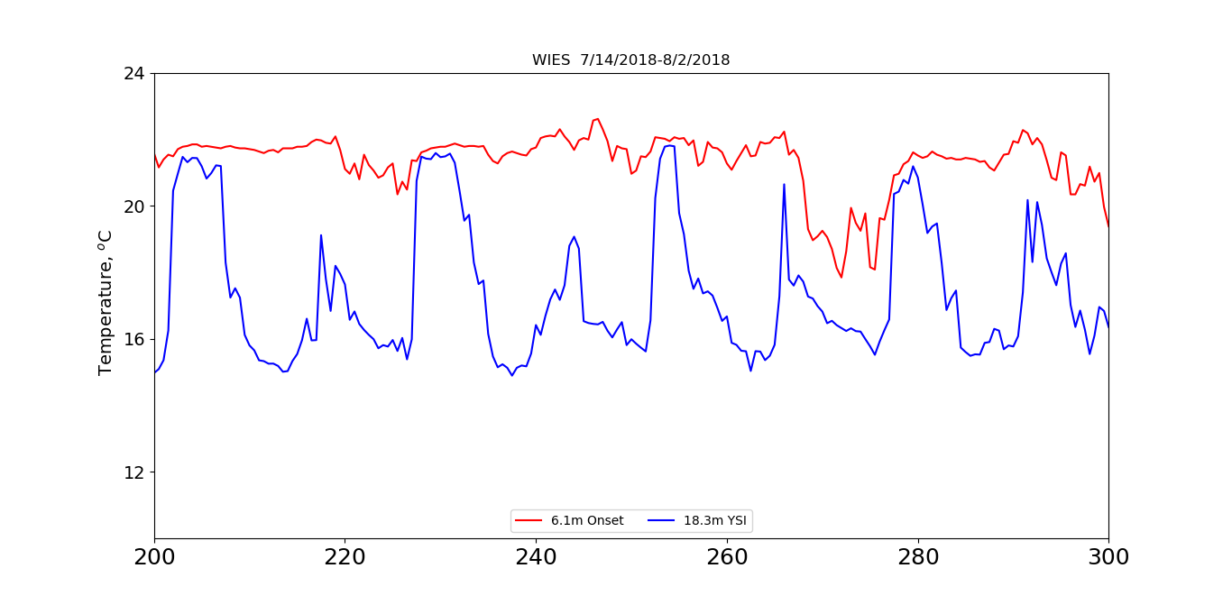
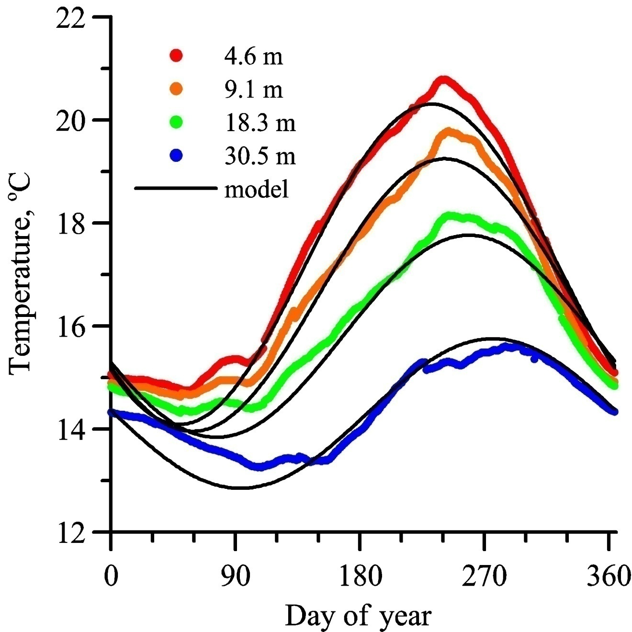
Temperature Data: Seasonal and Daily
Average of Catalina sites from 1992-2001
Two Harbors, July 8-11, 2018
Temperature ºC
6.1 m
18.3 m
IW downwelling
Hours
Notes:
Left side average temperature versus time of year parameterized by depth, 4 – 30 m. Note that the near surface temperature changes by 6 degrees over the year. The temperature change is greater at the surface than at depth. Seasonal temperatures are sinusoidal as shown in the model, though the phase, time of maximum temperature, progresses with depth. Note also that the modulation has greater amplitude for shallower depths.
Right side: Temperature at two depths, over the short time scale 72 hours. Near surface is relatively constant, while at-depth temperature varies greatly. Indeed, the daily variation at depth is the same as the annual variation at the surface.

Slide 5
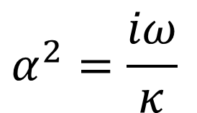
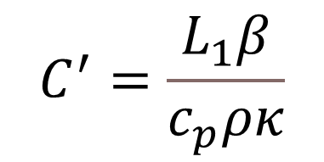
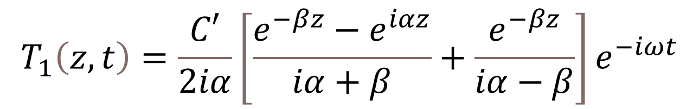
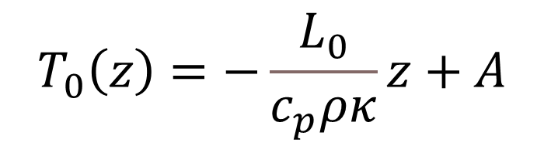

Physics-based SCB Seasonal Temperature Model
$$T\left(z,t\right)=T_{0}\left(z\right)+T_{1}\left(z,t\right)$$
T, temperature ºC
z, depth, meters
t , time of year, seconds
$$T_{1}\left(z,t\right)=\frac{C′}{2iα}\left[\frac{e^{−βz}−e^{iαz}}{iα+β}+\frac{e^{−βz}}{iα−β}\right]e^{−iωt}$$
$$T_{0}\left(z\right)=−\frac{L_{0}}{c_{p}ρκ}z+A$$
Parameter | Name | Value
κ | Vertical eddy diffusion coef. | 1.1 x 10⁻⁴ m² s⁻¹
β | Light extinction | 0.435 m⁻¹
ρ | Density of sea water | 1024 kg m⁻³
c_{p} | Specific heat of water | 4186 J kg ºC⁻¹
L_{o} | Mean surface flux | 82.7 W m⁻²
L₁ | Amplitude of surface flux | 125.3 W m⁻²
ω | Angular frequency of year | 2π/(31.577x10⁶s)
A | Surface mean temperature | 17.7 ºC
$$C^{′}=\frac{L_{1}β}{c_{p}ρκ}$$
$$α^{2}=\frac{iω}{κ}$$
Diffusion coefficient similar to ocean closure requirement
Notes:
In explaining the seasonal variation, we look at the solar heating of the ocean. We also have a physics-based model, as time and depth, describing the heating and mixing of the surface waters. An analytic model is a capital thing to have in your back pocket, and can be easily coded in Excel or python to provide a quick quantitative description of temperature dynamics.

Slide 6
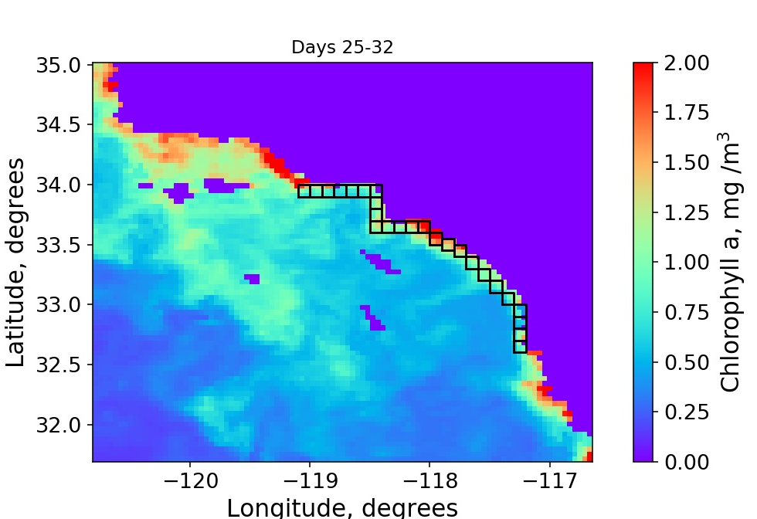
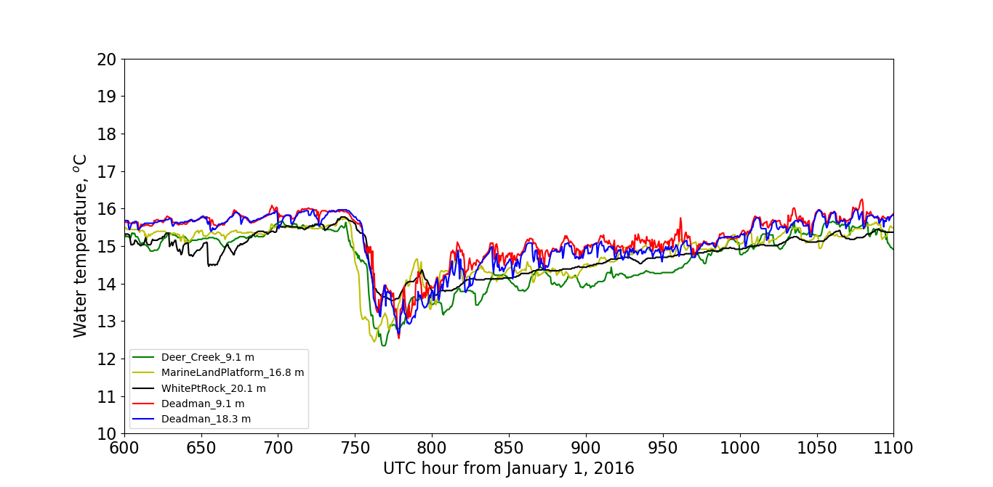
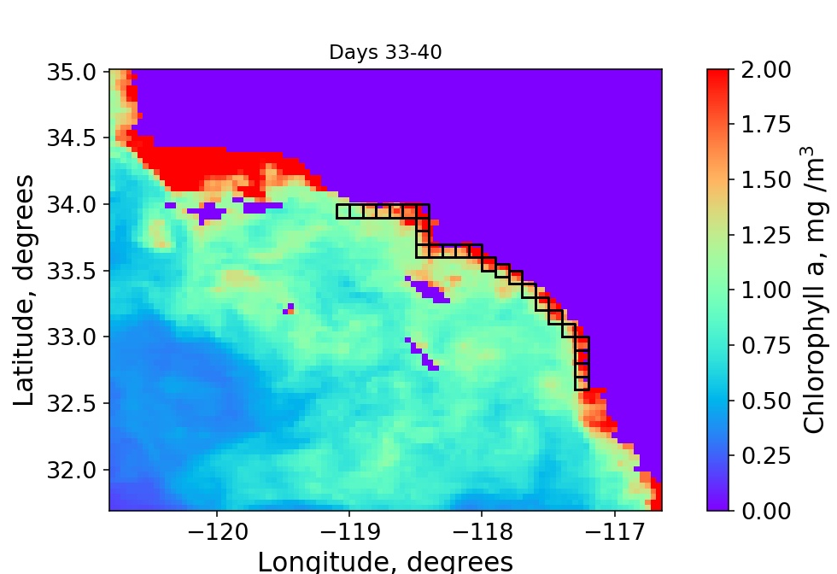
Wind-induced Upwelling Along the Coast
Upwelling-induced Chl a change
x
x
x
x
X - CMS thermograph
Notes:
At least some of the vertical mixing is generated by the wind. Especially during the winter. Here is the temperature change at some of our stations, noted on the map, on the coast (left) .
This upwelling resulted in an increase in chlorophyll a across the bight, especially offshore here in the Santa Barbara Channel and along the SoCal mainland coast.

Slide 7
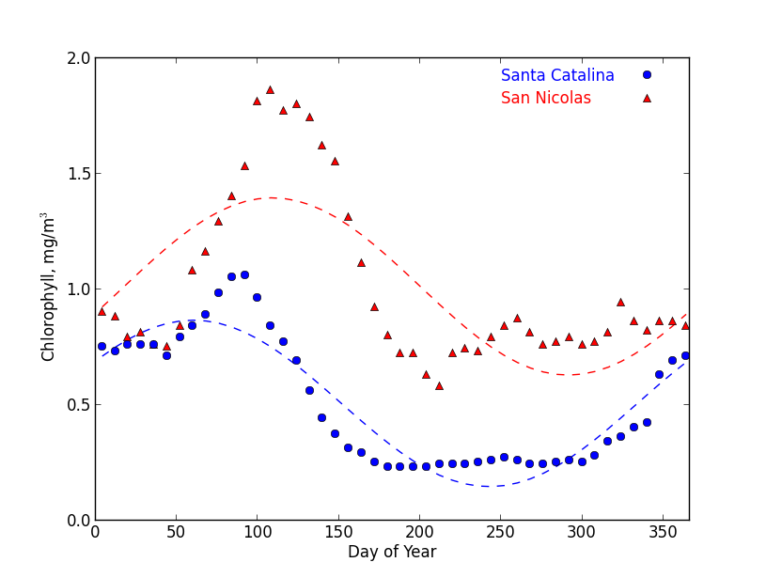
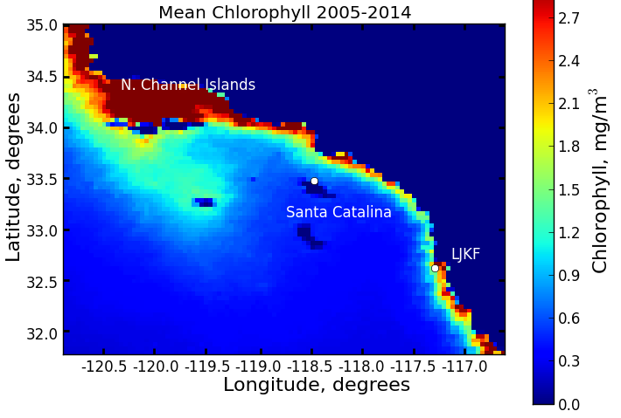
Remotely-sensed Chlorophyll averages
Ekman upwelling brings nutrients to the surface along the coast of Central and Northern California. Underwater ridge near San Nicolas island directs deep water toward the surface
Relatively little chlorophyll around Catalina and San Clemente
Indicative of nutrient availability and consistent with little upwelling at Catalina/Clemente
Notes:
Look how this plays out in the annual average. Little chl at Catalina and San Clemente compared to the other islands. This is the result of less nutrients due to less upwelling.
San Miguel sits on a peninsular that, we believe, is conducive to upwelling as deep currents must lift deep water above the ridge.

Slide 8
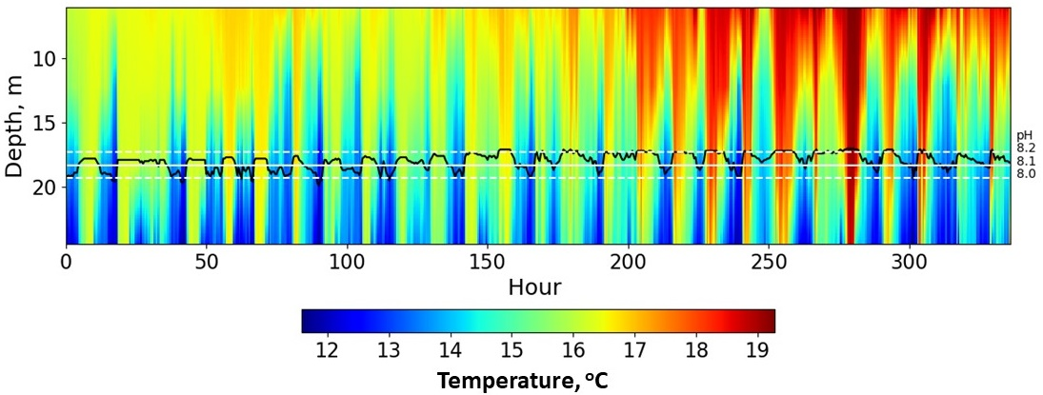
Daily pH and Temperature vs. Depth
Temperature at depth changes dramatically over a tidal cycle
pH is highly correlated with temperature and therefore water
Dynamic pH is not due to biological activity
Two Harbors
18-m depth

Slide 9
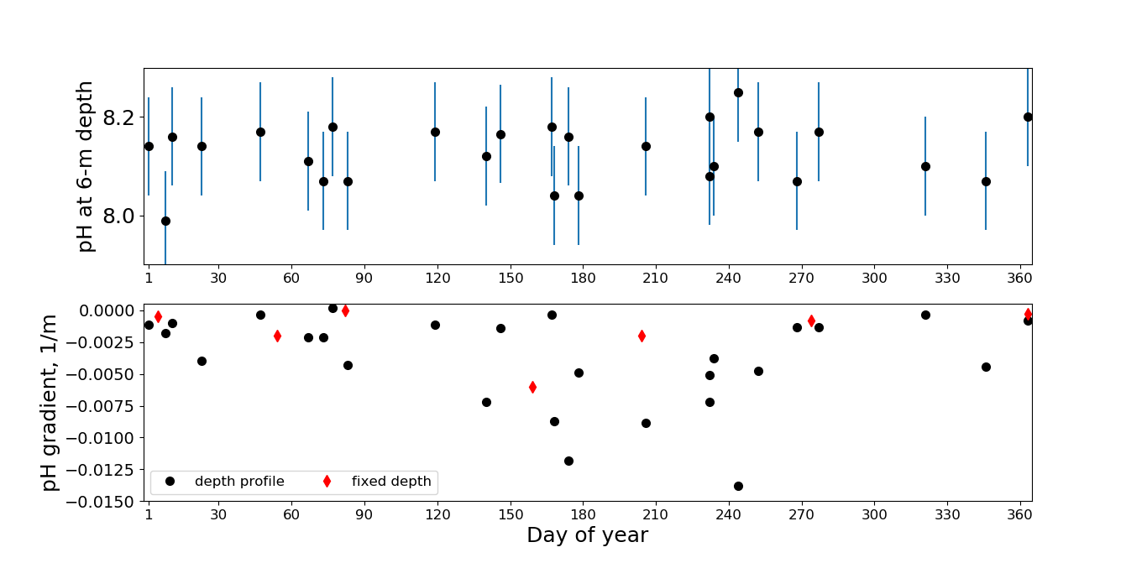
Seasonal pH from depth profiling at Catalina
Eff. Const
pH near surface

Slide 10
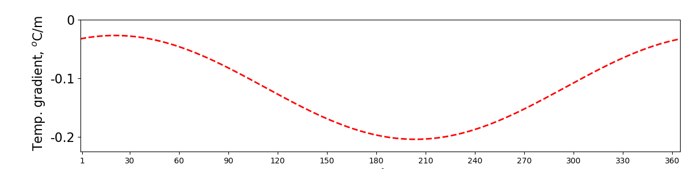
pH variability and stratification
pH variability is produced by internal wave sampling

Slide 11
pH throughout the Bight
Reference and location | pH (extrapolated by CMS to 18 m)
Frieder: La Jolla Kelp Forest | 7.86
Kapsenberg: San Miguel | 7.88
Kapsenberg: Santa Cruz | 7.83
Kapsenberg: Anacapa | 7.87
Leinweber: S. Monica Bay Observatory | 8.07
Alin: model applied to CalCOFI SoCal Bight | 8.05
Alin: model applied to CMS data | 8.04
CMS: fixed depth | 8.13 ± 0.04
CMS: depth profiling | 8.06 ± 0.07
8.09 average
Inner SCB, including Santa Catalina, has higher pH

Slide 12
Conclusions
Inner bight, including most of the southern Channel Islands, has relatively little upwelling (San Nicolas excepted)
Higher temperature
Less primary production (chlorophyll)
Higher pH at Catalina (and probably at San Clemente)
Greater wind-induced upwelling at mainland
Implying smaller pH there
Additionally, island pH is biased high due to internal wave downwelling at island (and mainland) submarine slopes
Southern Channel Islands may be Ocean Acidification Refugia
Little upwelling, summer downwelling provides higher pH (less acidity) regions in the SCB

Slide 13

Acknowledgments and References
Aquarium of the Pacific, California Science Center, Channel Islands National Park
American Legion Yacht Club, Antelope Valley Desert Divers, Catalina Island Conservancy
UCLA, NOAA, Scripps Institution of Oceanography
Seasonal and high-frequency ocean temperature dynamics at Santa Catalina Island. Craig Gelpi and Karen Norris. Proceedings of the Sixth California Islands Symposium, Ventura, California, December 1–3, 2003, Tech. Publ. CHIS-05. Vol. 1. 2005.
Seasonal temperature dynamics of the upper ocean in the Southern California Bight, Gelpi, C. G., & Norris, K. E. (2008).. Journal of Geophysical Research: Oceans, 113(C4).
Diurnal and Semi-diurnal Internal Waves nearTwo Harbors, Santa Catalina, California, Craig Gelpi, Monographs of the Western North American Naturalist,Vol. 7 (2014), pp. 21-34 (14 pages)
Chlorophyll Dynamics Around the Southern Channel Islands, Craig Gelpi, Western North American Naturalist, 78(4):590-604 (2018). https://doi.org/10.3398/064.078.0404
Wind-Event-Induced Ocean Upwelling, Relaxation and Chlorophyll Response in the Southern California Bight, Craig G. Gelpi, Bulletin of the Southern California Academy of Sciences (2023) 122 (2): 80–100.
Influence of shoaling internal waves on nearshore ocean pH, https://doi.org/10.20935/AL3379
Dynamics of pH at Santa Catalina Island PONE-D-23-12055R1, In Press (2023)
References in Red are in California Island Symposium Proceedings.

Slide 14
Abstract
For two decades, the Catalina Marine Society has researched the marine environment of Santa Catalina Island and the Southern California Bight. Initially concentrating on ocean temperatures, results include establishing the vertical diffusion coefficient during spring and summer, as well as illustrating the existence of ubiquitous large internal waves on the island’s submarine slopes. The relatively simple seasonal temperature dynamics led to an analytical seasonal temperature model for the central bight. The complicated internal wave structure at Two Harbors, an exceptional location both due to the near-sea-level pass connecting the windward and leeward sides, as well as the site of substantial research assets and studies, was analyzed and explained. Temperature studies led to remotely-sensed-chlorophyll analyses and we note that there is less chlorophyll around the warmer Santa Catalina Island than that found off the colder northern islands including San Nicolas. Similarly, recent in situ measurements of pH at Catalina, when compared to other measurements made around the Southern California Bight, indicate Catalina waters are less acidic than those of the other islands. We conclude that the general lack of upwelling plus the influence of internal waves leads to Catalina waters being warmer, less productive and less acidic than those of the other Channel Islands, perhaps with the exception of San Clemente and Santa Barbara.

Slide 15
Temperature variation and time scales
Seasonal variation
Large amplitude at the surface
Smaller at depth, and modulation phase is depth dependence
Indicates the rate heat diffuse from surface to depth, conversely, rate that nutrients move to surface
Coincidentally?!?!, vertical diffusion coefficient value is that required for ocean circulation closure
Daily variation indicates the diode-like action of surface water being transported to depth
Small amplitude near surface
Large amplitude at depth
Internal waves interacting with island submarine slope
Average temperature and other properties at depth (to ~ 30 m) are biased by this action
Episodic variations
Greatest wind-induced upwelling found along the coast and Santa Barbara Channel

